Slide 1

Departmental Workshops & Engagement
Adam J. Martin, Open Raleigh Manager
@OpenRaleigh

Slide 2
Data Management Trainings & Workshops
Topics
Why does liquid data matter?
Intro to Data Management (& related IT services)
Work Session: What’s Your Data Story?
How to use Socrata (Finding, Uploading, Creating Views)
How to use ArcGIS (Data Analysis)
Data Inventories
What is Metadata and why important?
How to structure Data?
Future Topics
Analysis in Excel (Beginner)
Pulling Data into Excel from Socrata
Excel Analytics Training (Pivot/Vlookups)
Advanced Data Exploration (Tableau)
Notes:
Feedback on why “liquid” data matters (i.e. “open data”)
o Provide a General Overview & Case Studies; give context to open data in other places and what it means for Raleigh? How open data adds value? To Org efficiency, to better decision-making?) Share internal/external case studies
o Discuss/Identify Data Sharing Pain Points among participants (HR data, finance/budget, Addresses, calendar, project data, etc)
o Empathy building for External Stakeholders/Citizens w.r.t. finding information
Establish a common language re: data & data management (Data vs. information, types of sharing, metadata, etc)
Share and discuss lessons learned from Stormwater Inventory & Prioritization Processes (e.g., how did we prioritize what data to share in open format? How did we engage stakeholders? Is there information the other departments could use to be more informed about Stormwater? is there information from the other departments that Stormwater could use for its operations? Share Stormwater’s key metrics with the departments).
Discuss Data Governance, policies and procedures: This topic could be combined with above topic, starting the discussion with issues arising out of Stormwater Inventory & prioritization discussion, discuss what principles should govern what data we would not want to default to “open”? Is the presence or absence of data management policies or procedures hindering or positively contributing to operations; creating security risks?)
Public Engagement: Who from public should be involved? What’s the right mechanism? Broad engagement or targeted representative engagement? If the latter, who should be part of an Advisory Commission? If the former, what are the right-sized communication strategies?
Socrata Training 101
· Explore what’s possible / not possible with the current tools we have
o Data automation
o Data visualizations
· Find, Create, and Embed Views of Datasets (Charts, Datalens)
· Pull live/updated data into Excel (Excel tep by step guide) and/or Tableau Public through an Odata connection
Intro to Data Management
Background on program
What we do? Internal Services view
What can be done?
All the Tools
Socrata (More) - Datalens
Showcase fun results from world GIS and Dataviz (internal & external)
How does “open” data fit into all of this?
What’s Your Story?
Envisioning your end game
Who are your audiences?
What do they want to know? top 10 requests
What do you want them to know? top 3 messages
Data Inventories
How to structure Data?

Slide 3
Data Management Introduction

Slide 4
Exercise: Can you find it?
Will Hillsborough St. get shut down for any special event during the holidays?
Which publicly managed Electric Vehicle station gets used the most in Raleigh?
What Parking Meter collects the most revenue?
Notes:
Take 15 minutes to see how many of these you can answer?

Slide 5
Liquid Data
How many of you have ever emailed a spreadsheet? Monthly?
Drop files in Corfile to share with another dept?
Post PDFs regularly on the website for external customers?
Pay a vendor to share data to external stakeholders?
Notes:
Take 15 minutes to see how many of these you can answer?

Slide 6
Open Data Discussion
Intro to Open Raleigh
Overview / Why Open Data
Services We Offer
Current Work
Tools / Demos
Socrata - Finding, Browsing Creating Views
ArcGis Online - Adding Data
What’s Your Story or Need?
Discussion on how we can help
Notes:
Introductions
Intro to Data Management
What we do? Services
What can be done?
Datalens
Showcase fun results from world GIS and Dataviz (internal & external)
How does “open” data fit into all of this?
What’s Your Story?
Envisioning your end game
Who are your audiences?
What do they want to know? top 10 requests
What do you want them to know? top 3 messages
Data Inventories
How to structure Data?

Slide 7
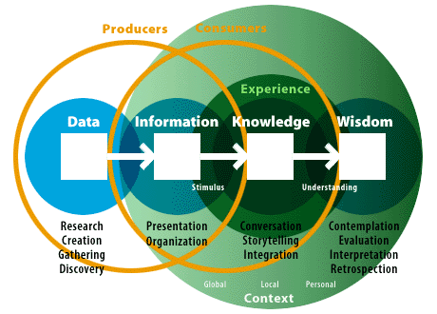
Data vs. Information
Notes:
Data (e.g. Transactions, Inbound Calls/Entries)
Aggregation
Operational Info
Strategic Info

Slide 8
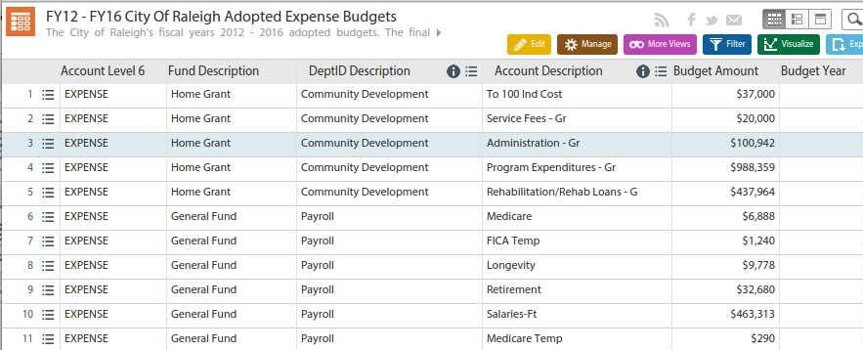
Metrics vs. Dataset
Measure | Total This Year | Goal Level
Dollars Spent on Overtime in Public Works | $ 1,748,670 | $ 1,144,383
Metric
Aggregate report, filtered on focus area
Single figure (attribute or row) (across one other variable like time)
Dataset
All Expenditures
Raw data, as Granular as possible (with Timestamps, All Types, All statuses)
Many rows & columns

Slide 9
What is Open Data? Classifications
Open Data
Non- Digital
Public Record
Sensitive
DigitalData
Protected / Exempt
Confidential
Physical Nature
How is info stored?
Legal Nature
Who has a right to the info?
Access Nature
How easy do we make it to get the info?
Notes:
Legal Nature: In 1995, NC passed public record laws Chapter 132
http://www.ncga.state.nc.us/enactedlegislation/statutes/html/bychapter/chapter_132.html
Open data is about how proactively and easily we make our data available for the public, and putting the data out in a way that makes it easier for companies and technologists to add value to the data.
We recognize that for some data, we may not want to lower the bar to 0 for access because departments. We propose

Slide 10
People Want the Data
Who are your data customers?
~30 million rows of data consumed per month by web and mobile applications**
83 datasets downloaded 400+ times
900+ Custom Views created*
1.5 million page views*
10,000 page views per month**
App Companies: Waze, Google Maps, local (RGreenway, DRA)
* Since March 2013 ** 6 month trailing avg
^ Updated 15 July 2015, across https://Data.RaleighNc.gov + http://data.ral.opendata.arcgis.com/
Notes:
1,800 visitors per month

Slide 11




Outcomes of Data Ubiquity
Better Decisions
Increased Quality
of Life
Efficient City
Services
New Business Models
Notes:
Hypothesis
Chicago, IL: Over a nine month period, its Department of Public Health (CDPH) experienced a 65% drop in the number Freedom of Information Act (FOIA) requests for environmental records by making the data available on the city’s open data portal. Open Data Annual Report 2013
Montgomery County, MD Reduced overtime expenses by more than $46 million since 2008.
Baltimore, MD Utilized data to minimize risk of double paying city contractors, saving the City $300,000.
New York, NY
Increased the rate of detection for dangerous buildings that are highly likely to result in firefighter injury or death.
Doubled the hit rate for discovering stores selling bootlegged cigarettes.
Louisville, KY
Removed more than two hundred days from key administrative processes, like hiring.
Reduced unscheduled overtime and workers’ compensation expenditures by more than $2 million.

Slide 12

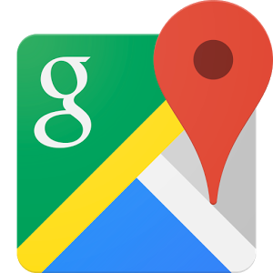



Getting the Data to the People
Map and Travel Apps
Public Transit (GTFS) & Bike Paths/Greenways
Road Closures

Slide 13



Raleigh’s Data Journey
towards a sustainable, high-value digital data management program
External Portal
300+ Datasets
Council Resolution
Launch pad
REST
12 million requests p.m.
iMaps
40,000 users p.m.
GIS
Wake County Collaboration
2005
2010
2013 - 2015
2020
Notes:
2005 - GIS Collaboration launching iMaps (addresses, parcel boundaries)
2010 - Refreshed iMaps, portal for exploring property information.
Raleigh developed it; County has support (Help Desk/Trainings)
2.9 million page views
660,000 total users
40,000 users per month
10 min per session
* Metrics averages Mar 2013 - Mar 2015
2011 - City Council Proposes Open Source Resolution to broaden the approach to property/permit data to other data
2012 Feb: Resolution Adopted Unanimously
2013 Mar: Open Data Portal Launch

Slide 14

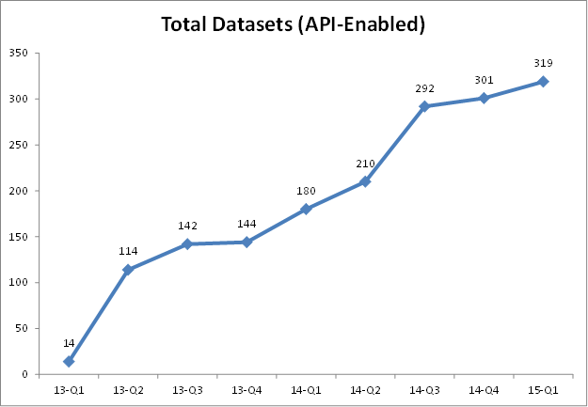
Open Raleigh - The Initial Push
March 2013 - Feb 2015
~300 Datasets Released with APIs
50% Tabular
50% Geographic

Slide 15
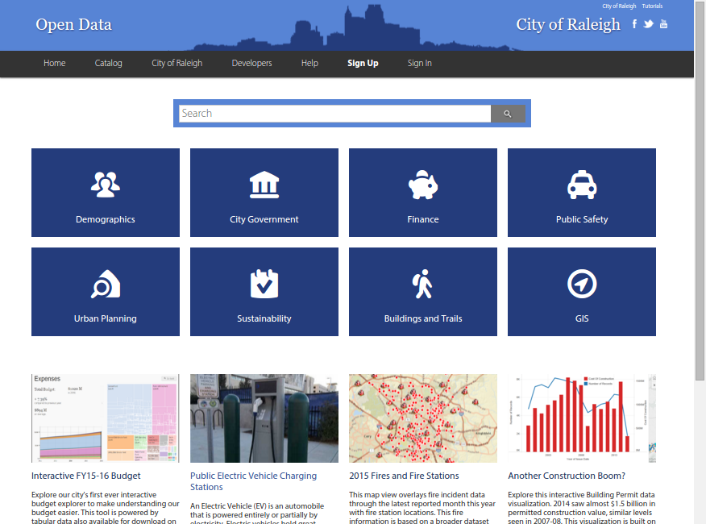
data.raleighnc.gov

Slide 16

Raleigh’s Data Journey
Cultivated Network
towards a sustainable, high-value digital data management program
Ubiquity - Push + Pull
Enterprise Data Program
Continuous Release
External Portal
300+ Datasets
Council Resolution
Launch pad
REST
12 million requests p.m.
iMaps
40,000 users p.m.
GIS
Wake County Collaboration
2005
2010
2013 - 2015
2020
Notes:
2005 - GIS Collaboration launching iMaps (addresses, parcel boundaries)
2010 - Refreshed iMaps Raleigh developed it; County has support (Help Desk/Trainings)
2.9 million page views
660,000 total users
40,000 users p.m.
10 min per session
* Metrics averages Mar 2013 - Mar 2015
2011 - City Council Proposes Open Source Resolution
2012 Feb: Resolution Adopted Unanimously
2013 Mar: Open Data Portal Launch

Slide 17
Focusing on Quality, Automation and Internal Value Propositions
What departments to you get data from for your work?
305 Datasets API-Enabled^
“machine-readable”
5 Automated Public Datasets
“refreshed regularly”

Slide 18

Guiding Principles of Data UX
🔎
Search First, Search Once
Meet People where they are
Smart Alerting
Embedded Insights (Raleigh Web, 3rd Party Apps)
Tell Stories around Strategic Themes
Operating / Capital Budget
Strategic Plan
Affordable Housing
Planning Process

Slide 19
The Data Stack
How you want to present information can impact how you collect information about activities and your business processes
Presentation
Dataset Access
Storage Data Sources
Digital Collection Software / User Interfaces
People and Activities

Slide 20
Open Data Program Goals
These goals should guide a 3 year strategy for institutionalizing open data across the City of Raleigh.
Goal 1. | Communicate Goals Across Government
Goal 2. | Improve Data Quality Mgt Processes (Expand, Enrich, Open)
Goal 3. | Lower Costs for Dept. to Publish (Automate)
Goal 4. | Departmental Service Delivery & Performance
Goal 5. | Better Data UX (Visualize, Search, Embed, Alert)
Goal 6. | Innovate with External Partners

Slide 21
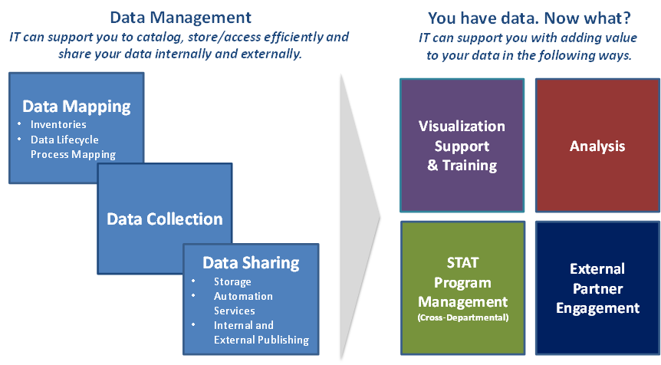
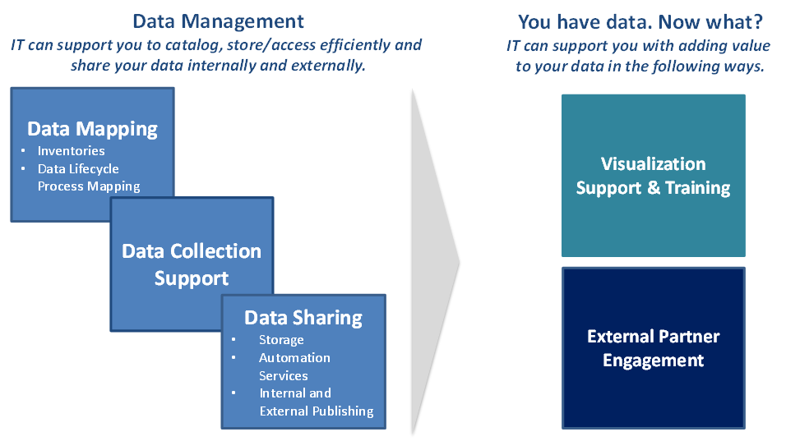
Open Data Program Services

Slide 22
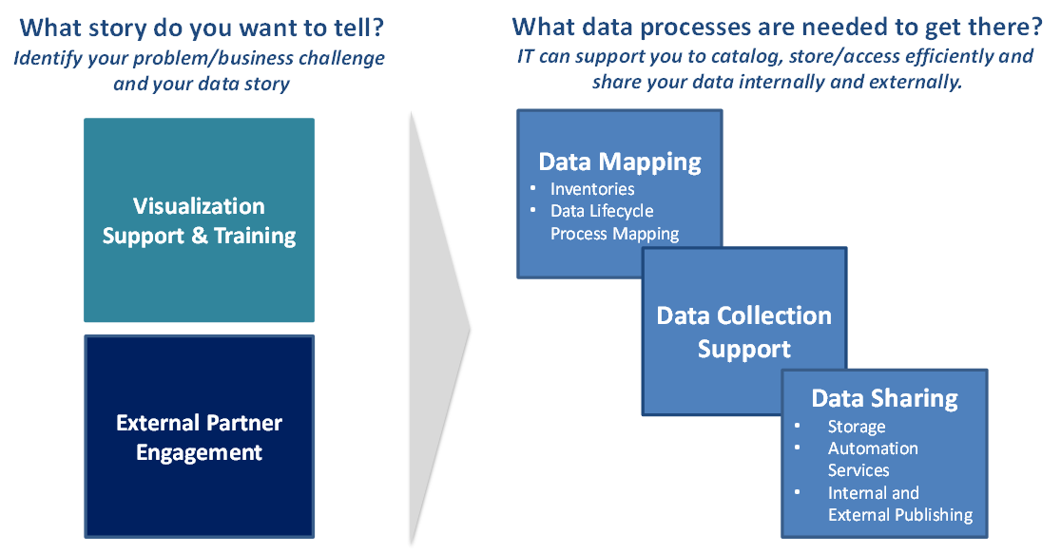
Open Data Program

Slide 23
Data Sharing - Model Process
Data Governance Check Point / Sign off
Sharing Internally
IT
Enrich & Expand (public catalog release)
Open Data (public release)
Community Engagement
(Event or Project)
Targeted Community Input
Inside Dept.
Other Depts.
* Inventory/“Data dump”
* Brainstorm Data Needs & Use Cases based on past requests
* Expedite publishing of “Low hanging fruit” and time saving data
* Provide IT Access
* Prioritize Datasets for automation / public release
* Add Metadata to Inventory
* Initial IT analysis of priority datasets
* Release Catalog
* Analyze/Clean
* Share with variety of key stakeholders
* Automate
* Communications
* Plan Engagement
* Feedback on useful structure of data
* Encourage innovative reuses of data to achieve city goals
* Respond / Support customers of data

Slide 24
Engagement Path
Performance Mgt Training
3 weeks - Wave 1
4 weeks
6 weeks
4 weeks
Data Management & GIS Training
Division 1
Expand
Enrich
Open
Community Engagement
(Event or Project)
Division 2
* Beginners targeting performance based data review
* Advanced for existing analysts
* NC Analytics Partnership
Division 3
* Inventory
* Brainstorm Data Needs & Use Cases
* Community Input
* Prioritize Datasets
* Add Metadata to Inventory
* Analyze/Clean
* Automate
* Communications
* Plan Engagement
Division 4
Assess Dept. Readiness

Slide 25
Tools / Demos
Socrata, ArcGIS, Examples

Slide 26






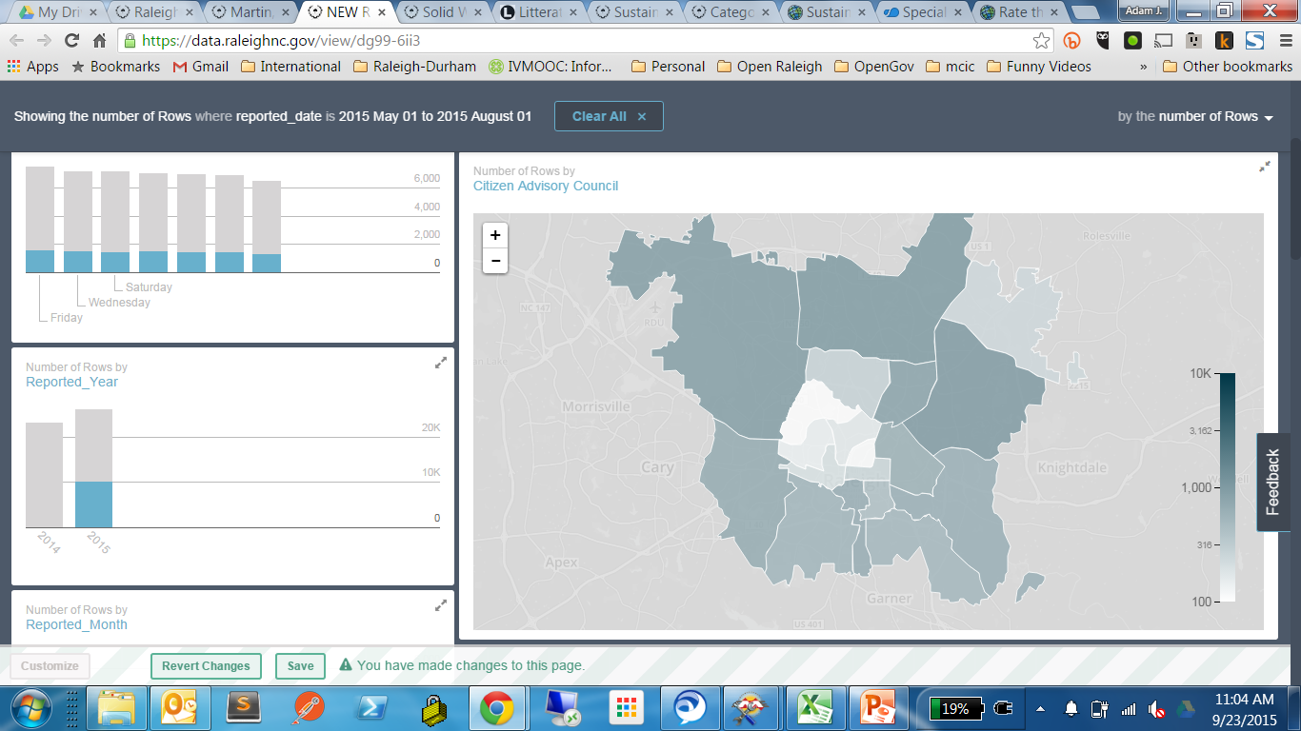
Our Tools / Partners
Data automation (ETL)
Web Forms for data collection
ArcGIS (App Studio)
Maps and Geo-Applications
Socrata
Open Data Portal for Shared Storage, Embeddable Charts + Visualization Lite
Custom / Open Source Web Dev
Interactive websites

Slide 27

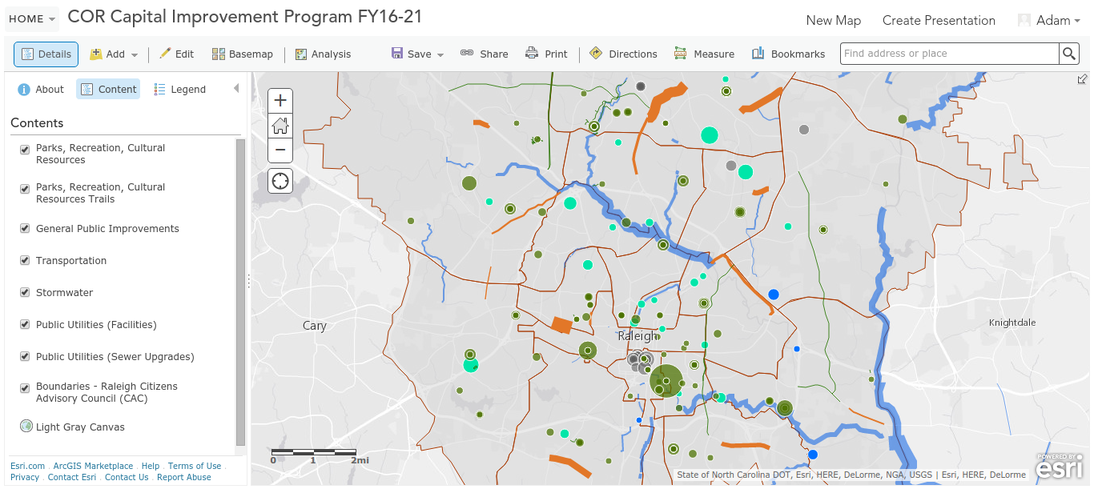
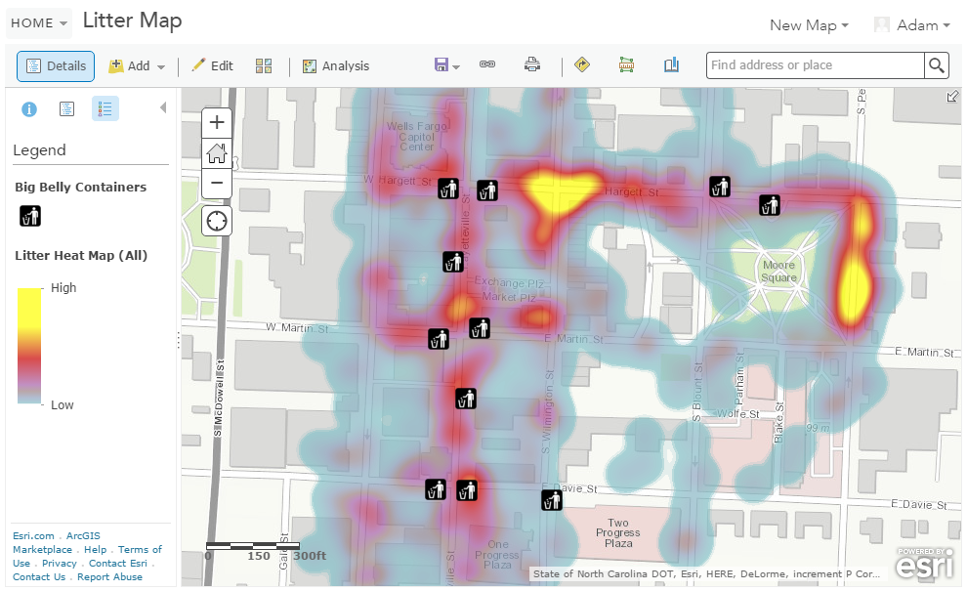
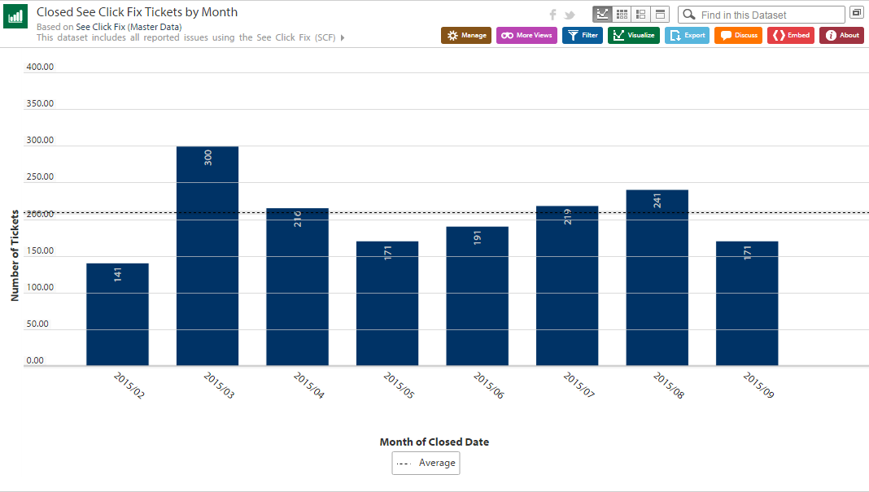
Our Tools / Partners
Data automation (ETL)

Slide 28
More on Socrata
Datalens for exploration

Slide 29
More on Socrata

Slide 30
More on ArcGis
Points on a map
Multiple layers of information
Easy web maps with address search
Add 3rd party data through Analysis feature

Slide 31
What’s possible? Easy
Points on a Map

Slide 32
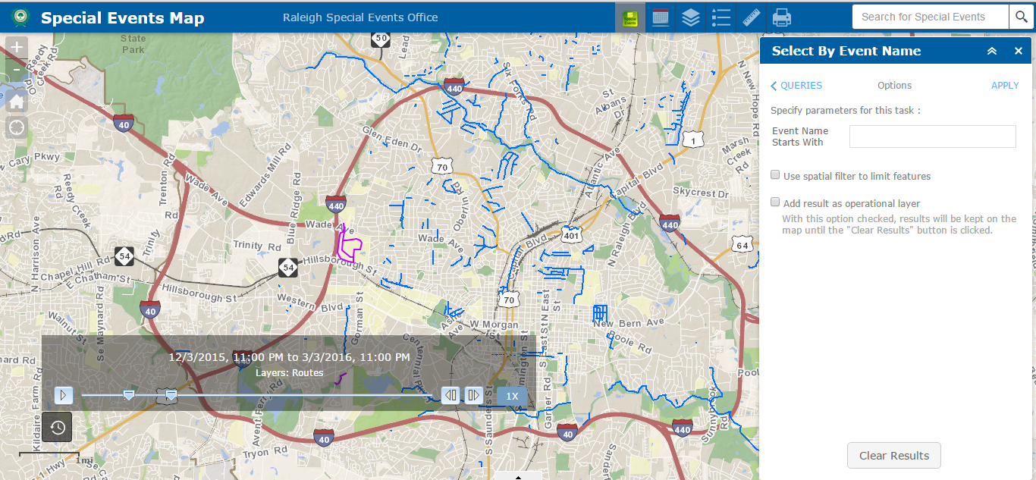
What’s possible? Medium
Interactive Map w/ Filters and Search

Slide 33
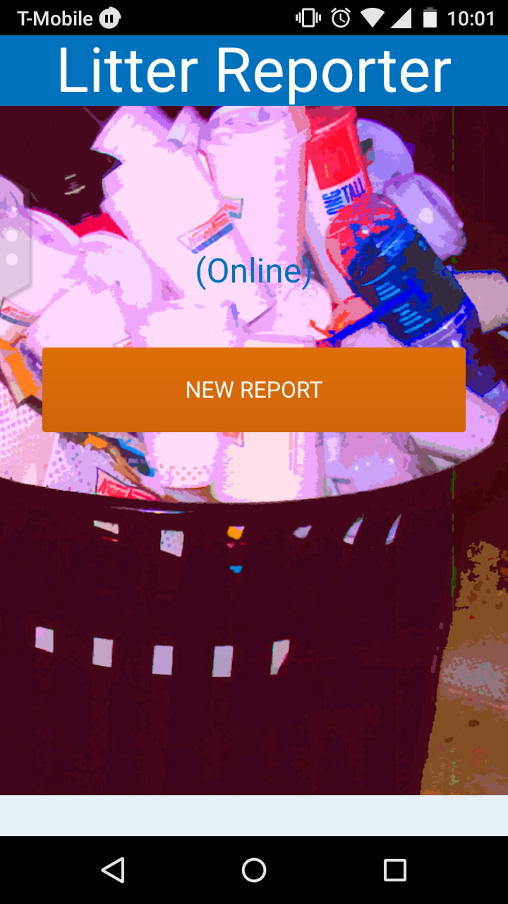
What’s Possible? Medium Difficulty
Mobile app with Form/Picture collection
Litter & Trash Can Placement
Data Collected: Litter Audit
Notes:
COR Level of Effort:
Prep: 10 hrs - discovery, feasibility, socializing with stakeholders
Delivery - 168 hrs
Adam: 67 hrs - project mgt/documentation, stakeholder mtgs/approvals, data reformatting, UI changes, Capital Map creation/tweaking, gathering feedback
Thor: 86 hrs - cloning, data processing, troubleshooting
Justin: 16 hrs - initial setup support, bug fixes, cloning to production, analytics set up
Chris: 12 hrs - UI fixes, CSS updates
Promotion/Communication: 8-10 hrs

Slide 34
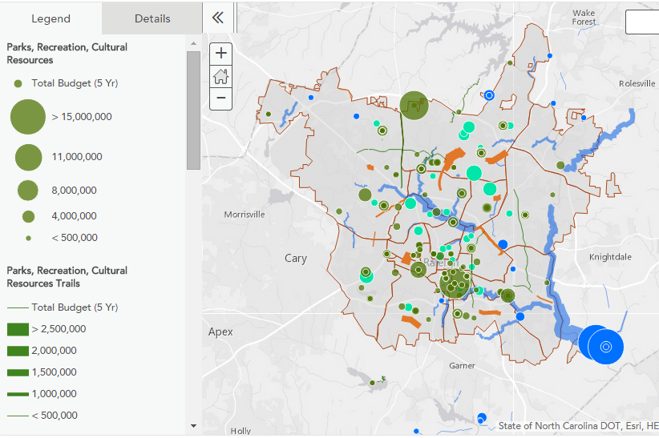
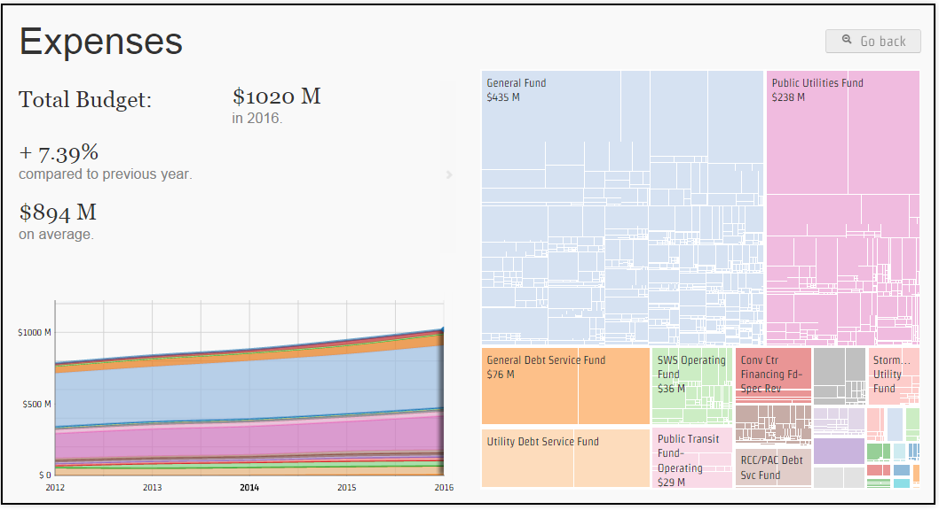
What’s Possible? Medium Difficulty
Adapted Custom Web Visualization
Data Used: FY16 Proposed & Adopted Budgets
Read More
http://openmaps.raleighnc.gov/budgetvisualization/
Capital Projects
Operating Budget (FY12-16)
Notes:
COR Level of Effort:
Prep: 10 hrs - discovery, feasibility, socializing with stakeholders
Delivery - 168 hrs
Adam: 67 hrs - project mgt/documentation, stakeholder mtgs/approvals, data reformatting, UI changes, Capital Map creation/tweaking, gathering feedback
Thor: 86 hrs - cloning, data processing, troubleshooting
Justin: 16 hrs - initial setup support, bug fixes, cloning to production, analytics set up
Chris: 12 hrs - UI fixes, CSS updates
Promotion/Communication: 8-10 hrs

Slide 35
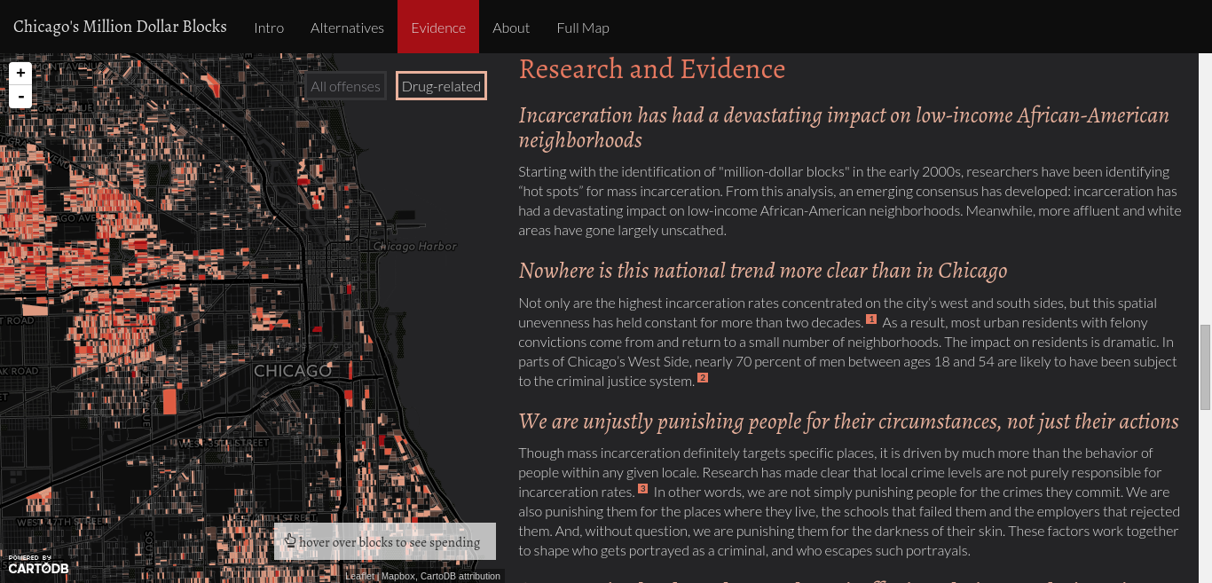
What’s Possible? More Difficult
New Custom Website w/ Ext. Partners
Notes:
Original Analysis
Leverage external partners

Slide 36
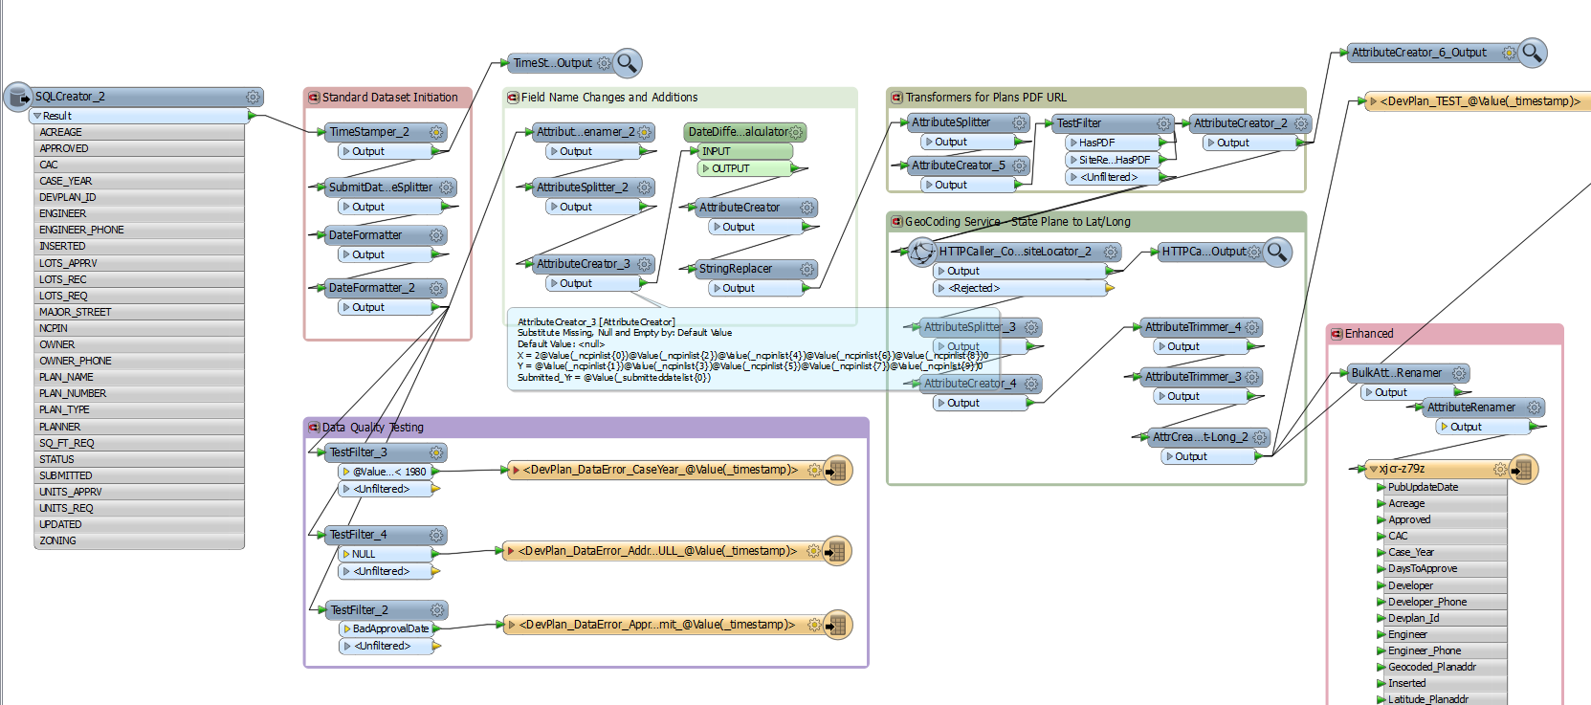
More on Sharing: Automation
Extract
Transform
Load

Slide 37
Sharing: Automation
Extract
Transform
Load
SQL/Oracle
Socrata
Access
GIS Rest Endpoint
XML
RSS
CSV
TXT
Reformatting
Rename Fields
Add Fields based on complex If/Then Logic or Field Calculations
String Replacements
Geocode Addresses
Filtering
Audits
SQL/Oracle
Socrata
Access
GIS Rest Endpoint
XML
RSS
CSV
TXT
Notes:
Transform - Days to Approve since submission
Create - URL for PDF

Slide 38


Guiding Principles of Data UX
🔎
Search First, Search Once
Meet People where they are
Embedded Insights (Raleigh Web, 3rd Party Apps)
Smart Alerting
Tell Stories around Strategic Themes
Operating / Capital Budget
Strategic Plan
Affordable Housing
Planning Process

Slide 39
Your Data Story / Needs
How can we help?

Slide 40
Existing Work Together - H&N
Rental Housing Inventory / Analysis & Interactive Maps
External Engagement - Challenge Brainstorming
Other H&N:
Neighborhood Boundaries / Official Updates

Slide 41
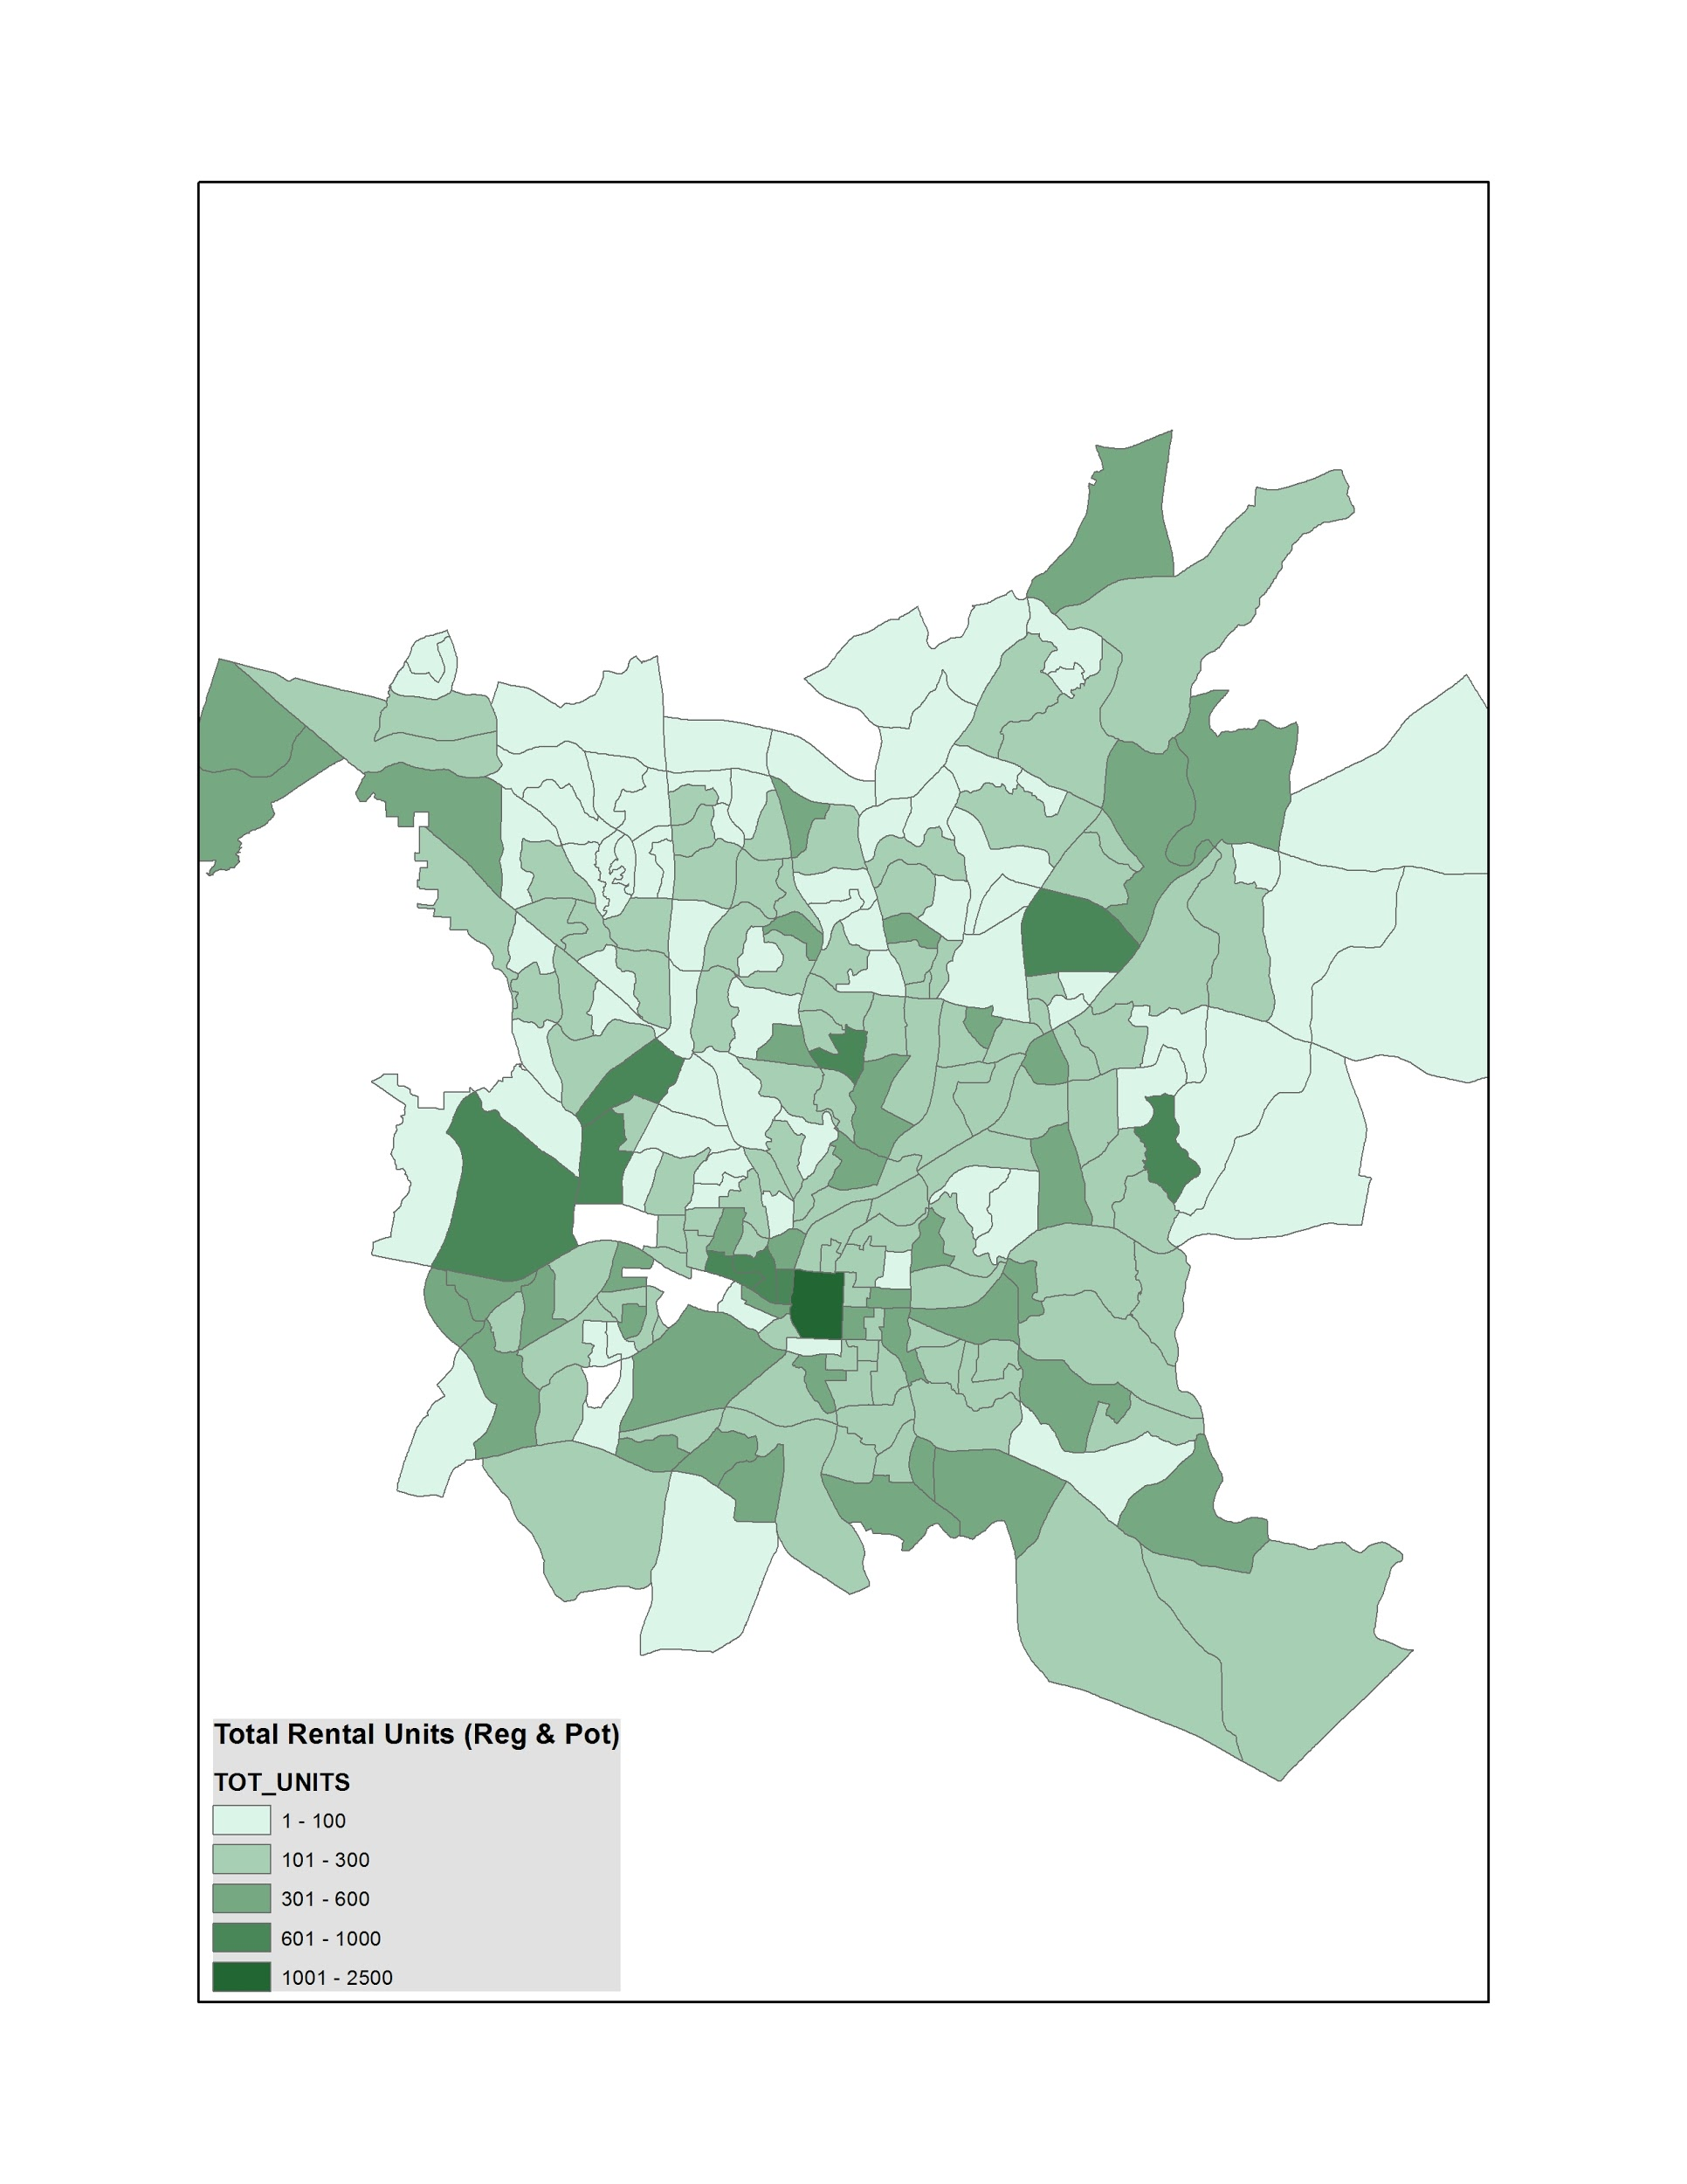
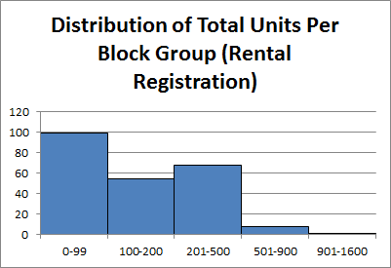
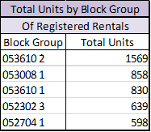
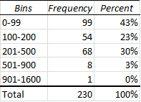
Where are the Rental Units?
Total Rental Units (2015 Registered + Potential by Block Group
Nbr of Block Groups
Units
Number of Rental Units

Slide 42
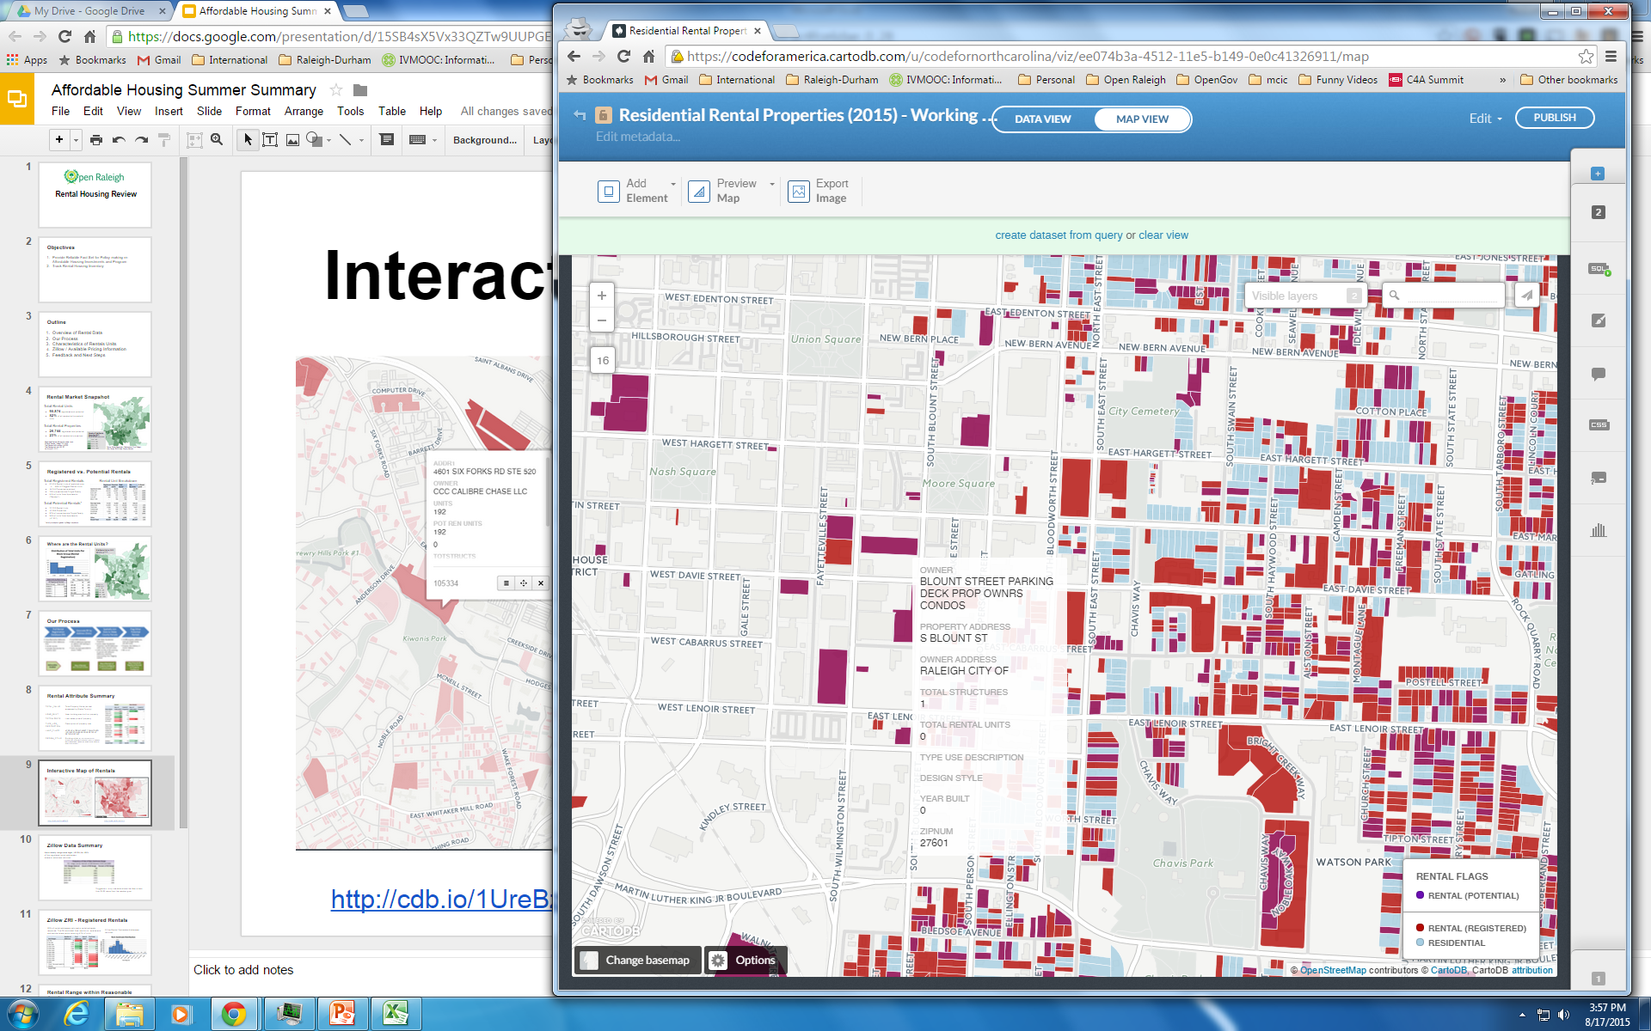
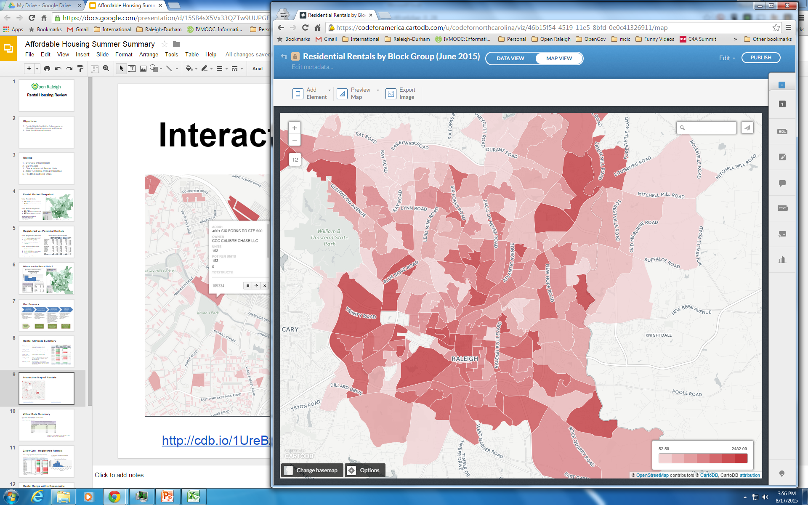
Interactive Maps of Rentals
http://cdb.io/1LhjQ3I
http://cdb.io/1LhkYUJ

Slide 43
What’s your data story?
Envisioning your end game
Who are your audiences/stakeholders?
What do they want to know? top 10 requests
What do you want them to know? top 3 messages

Slide 44
Inventory Workshop

Slide 45
Agenda
Process Approach (20 min)
Story-Telling vs. Inventory
A Single Dataset Journey
Data Inventory Brainstorming (1 hr)
Data You Own
Data You Need
Sources
Prioritization
Socrata Training (30 min)
ArcGIS Training (30 min)
Notes:
What are we working with?

Slide 46
Open Data Program

Slide 47
What’s your data story?
Envisioning your end game
Who are your audiences? Local End Users, Council, Federal/Compliance Orgs, Grant Funders
What do you want them to know? top 3 messages
What do they want to know? top 10 requests

Slide 48
What’s your data story?
To Council & Advocates
We are a 4-Star City
Raleigh is at 20% of bigger sustainability goal
Raleigh are saving 20% of energy costs due to efficiency programs and monitoring
Will save X% with our Lighting program
Raleigh is a leader in solar generation among municipalities
End Users (Recycling, Water Usage Programs)
Citizens have power to impact planet

Slide 49
Open Data Program

Slide 50
Metrics vs. Dataset
Measure | Total This Year | Goal Level
Dollars Spent on Overtime in Public Works | $ 1,748,670 | $ 1,144,383
Metric
Aggregate report, filtered on focus area
Single figure (attribute or row) (across one other variable like time)
Dataset
All Expenditures
Raw data, as Granular as possible (with Timestamps, All Types, All statuses)
Many rows & columns

Slide 51
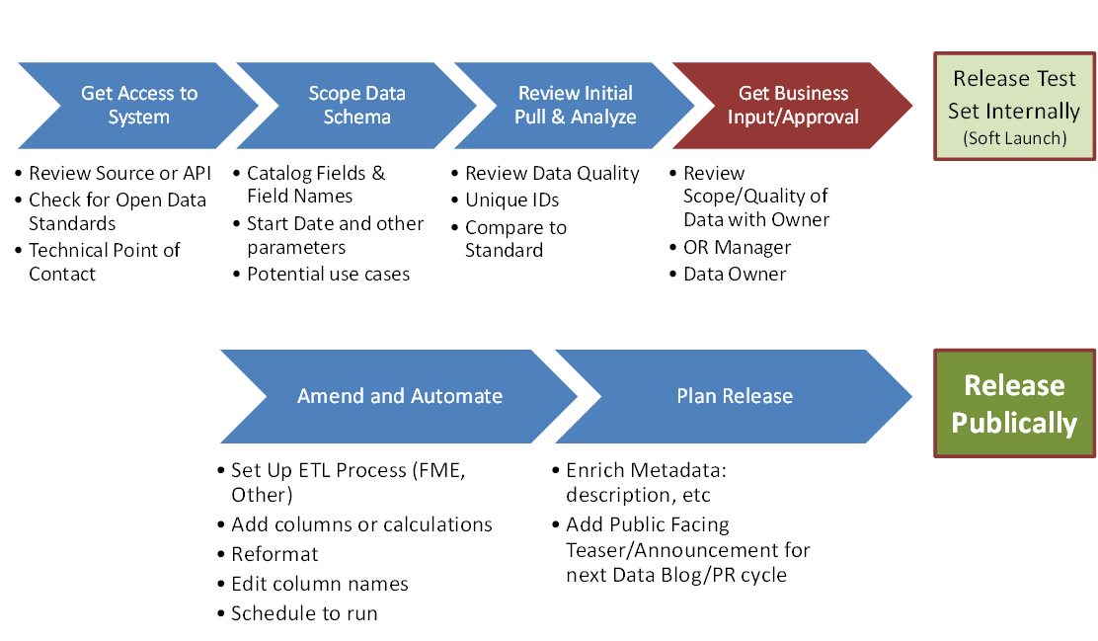
A Single Dataset Journey

Slide 52
Data Sources - Brainstorm
Data you own
What data sources does your department maintain? Where are you the official source of record?
What data is reported to federal, state or local agencies?
What departmental data is currently publicly available on Data.RaleighNC.Gov or elsewhere online?
What data populates your monthly or quarterly reports? Do you use for internal performance and trend analysis?
What data has been requested under FOIA? Talk with the Public Affairs Officer (Michael
What data do other departments ask you for?
What kinds of open data are similar agencies publishing across the country?

Slide 53
Data Sources - Brainstorm
Data you own
What data sources does your department maintain? Where are you the official source of record? Big Belly
What data is reported to federal, state or local agencies? STAR Evaluation Report, ICMA-Sustainability Survey
What departmental data is currently publicly available on Data.RaleighNC.Gov or elsewhere online?
Sustainability Projects Map
NC Charging Stations (F&O)
Recycling Collection Days/Zone Map (PW)
Solid Waste Collection Points and Schedule (SWS)
Leaf Collection Zones (SWS)
NC Project LEED Certifications (3rd Party- BIG)
Searches?
http://www.raleighnc.gov/sustainableraleigh

Slide 54
Data Sources - Brainstorm
Data you own
What data populates your monthly or quarterly reports? Do you use for internal performance and trend analysis?
What data has been requested under FOIA? Talk with the Public Affairs Officer (Michael
What data do other departments ask you for?
What kinds of open data are similar agencies publishing across the country?

Slide 55
Data Sources - Brainstorm
Data you need / consume
What applications or systems do you currently use to access data?
What data do consultants ask for?
Where do you get stuck when filling out reports / surveys?

Slide 56
Data Sources - Brainstorm
Periscope (Facilities & Ops)
BigBelly (Sustainability)
Notes:
http://mapstest.raleighnc.gov/raleigh-charged

Slide 57
Datasets Brainstorming
bit.ly/corsustain
Aggregated energy (gas and electric) usage by city buildings (F&O, Periscope)
Number of alternative fueled (public-owned) vehicles (Public Works?)
Number of electric vehicle charging stations, locations and usage (Periscope or NC stations)
Total waste collected from big bellies (Jim / Alerts when Emptied)
Residential solid waste and recyclables collected in tons per month
Total fuel usage for vehicles (public vehicles?) (SWS, RPD, F&O - PeopleSoft?)
Sustainability Projects Map
NC Charging Stations (F&O)
Recycling Collection Days/Zone Map (PW)
Solid Waste Collection Points and Schedule (SWS)
Leaf Collection Zones (SWS)
NC Project LEED Certifications (3rd Party- BIG)

Slide 58
Datasets Brainstorming
By Storyline
By Program
By Report

Slide 59
Prioritization
Goal to bucket into 1 (no more than 10), 2, or 3 waves of effort
1 | Demand | Validated Demand (External or Internal) | Higher scores where demonstrated demand from external parties or value estimated in cost savings or service quality improvements that data sharing would created.
2 | LOE | Level of Effort to Automate. | This factor is dependent on amount of data automation resources the City can deploy. Department Data Coordinators and/or the Open Data Program Manager may deprioritize datasets that are costly until there is sufficient demand to balance out the costs.
3 | Strategic | Alignment with COR Strategic Plan or Key Story | This factor could be considered internal validation per factor 1, and/or would take precedence over other datasets competing for automation with limited resources.
4 | Urgency | Time-Sensitive Release? | If a strategic initiative relies on the release of certain datasets at a particular point in time. The nearer the deadline, the higher the score.

Slide 60
Socrata Exercises
Goal: Update the Description for the sustainability projects dataset
Goal: Create a filtered map of EV Charging Stations in Raleigh overlayed by CACs
Goal: Show trend in energy usage per building

Slide 61
ArcGis Exercise
Goal: How many residential households are with a ¼ mile radius of bus stops?
Logins
Bus Stops (load spreadsheet with addresses
Create buffer
Add data

Slide 62
Departmental Engagement Plan
Who needs IT help with data management across departments?
Who engages with public a lot with complex data?
Which depts. have the most interesting datasets?
Departmental Engagement Priority Score
Internal Data Mgt Support | Public Engagement | High Value Datasets | Existing Relationship | Performance Mgt. Targets
How is data shared across departments? Excel/Email only? | How much regular public engagement core to their mission and activities? | Does this department align with popular data requested, and or anticipated to be high value for strategic plan? | Do we have positive working relationships with key influencers? | Is this department key for Performance Management

Slide 63
Departmental Engagement Plan
Phase 1
Raleigh Police Department
Planning - Permits
Fire (revise)
Budget & Management Services (May/June)
Phase 3
Solid Waste Services
Convention Center
Economic Development
Parks, Rec, & CR
Housing & Neighborhoods
Public Utilities
DRAFT LIST
Phase 2 - Data Customers
Sustainability
Urban Design
Finance
Public Works

